Slide 1
Territorial Acknowledgement
Karly O’Neill
Geography 241 – Summer 2022

Slide 2
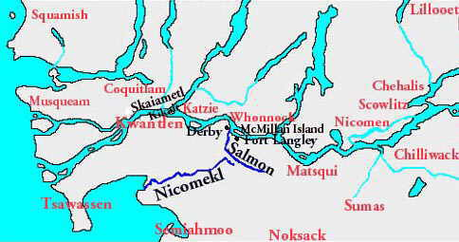
Acknowledgement
The traditional and unceded territory of Coast Salish Peoples, specifically the Kwantlen, Katzie, Semiahmoo, and Matsqui First Nations.

Slide 3
Language and Meaning
A quote taken directly from the Kwantlen Technical University says that “Kwantlen translates to tireless runner. Following our rich legacy and traditions, we continue to work tirelessly at building a strong sense of community within our traditional territory.”

Slide 4
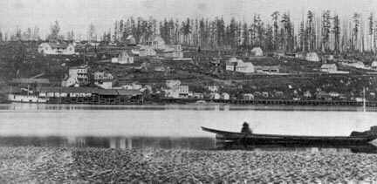
History
Over twelve thousand years ago, the Coast Salish people resided in this area and continue to do so today.
Simon Fraser explored the river along Langley
The creation of the Fort by the Hudson’s Bay Company

Slide 5
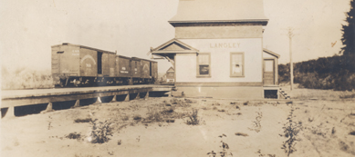
Colonial Effects
Gold Rush 1858
Railways 1905 and 1910
No residential schools on this land

Slide 6
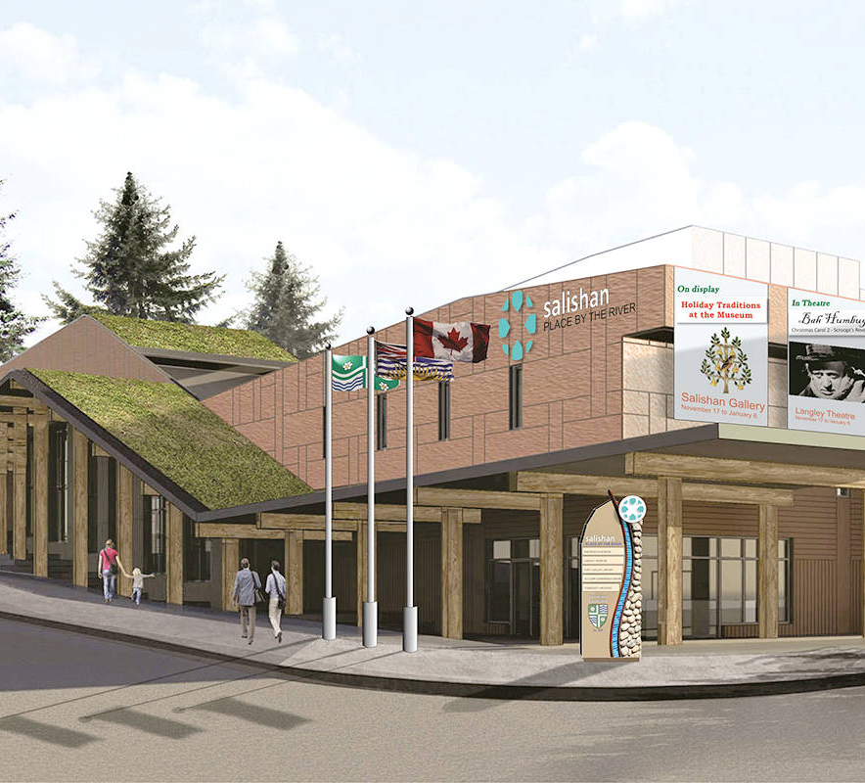
Development & Current Use
Highway completion
Suburban communities
Farmland
New Salishan Place by the River

Slide 7
Reflection
I am honoured to live on this beautiful Coast Salish territorial land.

Slide 8
References
https://mapsvr.tol.ca/OurSharedHistory/#
https://www.kwantlenfn.ca/#:~:text=Kwantlen%20Traditional%20Territory%20extends%20from,northernmost%20reaches%20of%20Stave%20Lake.
https://www.pc.gc.ca/en/lhn-nhs/bc/langley/culture/histoire-history
Canada's Residential Schools - Google Earth Voyager Story (link can only work on the Google Chrome browser): https://earth.app.goo.gl/iL67
Native Land map (https://native-land.ca/);

